Slide 1
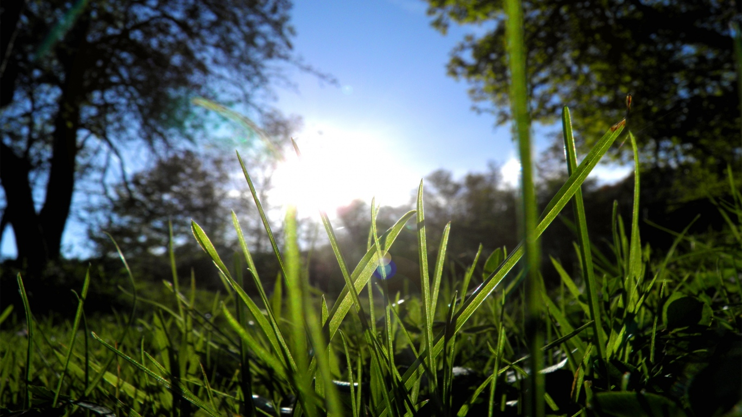


The Best Summer Ever

Slide 2
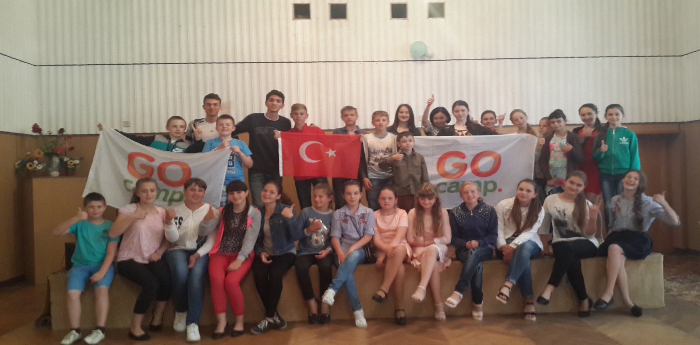
Go camps is a great project that gives us new opportunities, new experience and good friends.

Slide 3
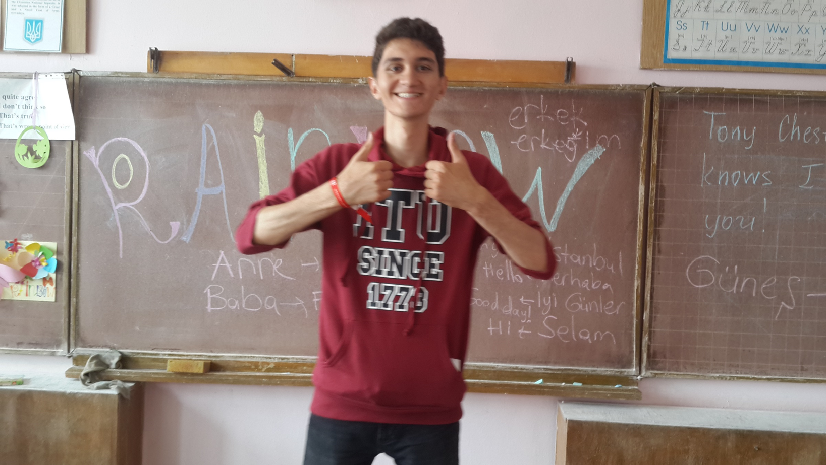
This summer was really special. We had a great time together. The teachers were full of enthusiasm while working with the volunteer. The pupils felt themselves comfortable and willing to discover something new through the communication.

Slide 4
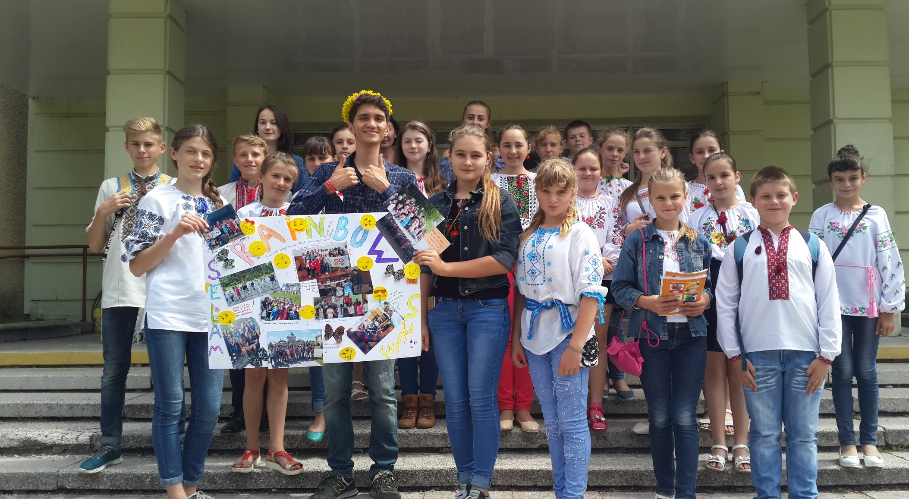
Alperen Ahioglu is a kind, sociable, friendly and polite young man. He has a talent of making everyone feel at ease. Our pupils liked him since the very first moments.

Slide 5
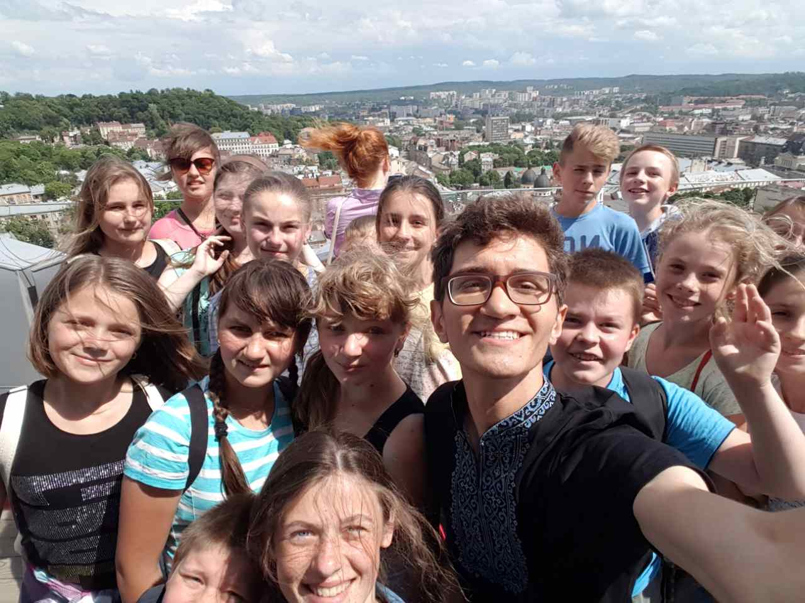
Every our day was full of communication, agile(lively) games

Slide 6
